Slide 1
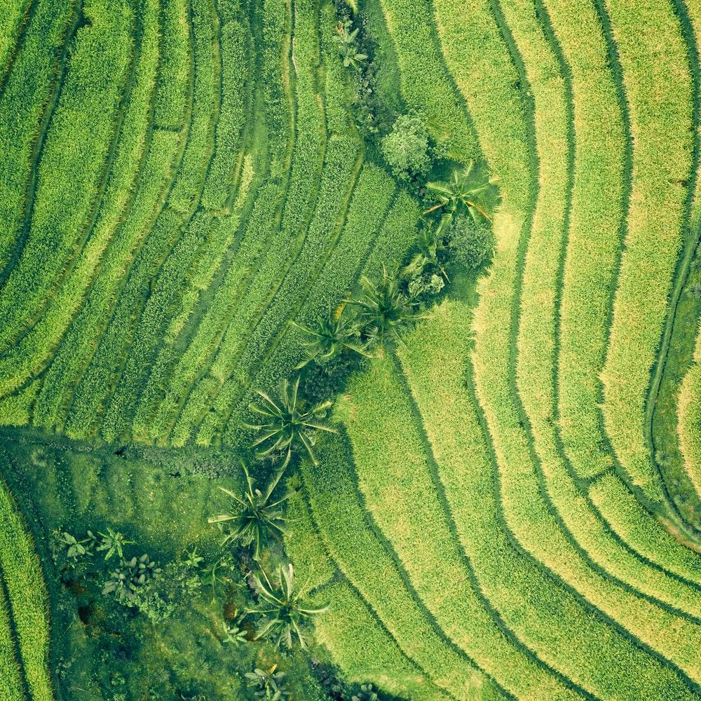
Save the Trees!
By: Noah Foilb

Slide 2

How has Boston done in terms of preserving nature?
Let’s look at the amount of trees in boston.

Slide 3
201,846 Trees
Whoa! That’s a big number, aren’t you proud?

Slide 4
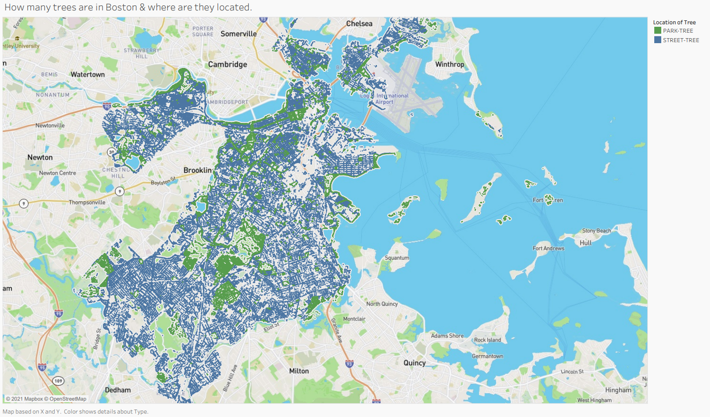
There are so many Trees!
There are so many street trees! This shows that Boston had made an huge attempt to keep trees in Boston! Not only that but there are huge of parks in Southern Boston!

Slide 5

Great!
As we can see Boston has made a huge effort to preserve the trees, especially impressive for a large and industrial city!

